Slide 1
ELECTRONIC TOLL COLLECTION USING PIEZOELECTRIC AND RFID SENSORS
Y.NAGA.SAI SUMANTH (18497)
V.RAMABHADRAM SAI (17552)

Slide 2
E-Tolls System-Knowledge
Four integral processing in Electronic Toll Collection (ETC) system.
Automation vehicle identification
Automatic vehicle classification
Transaction processing
Violation Enforcement
Reference :
“Electronic Toll Collection System”, http://en.wikipedia.org/wiki/Electronic_toll_collection
“Apex Committee Survey Report on Statistics of Electronic Toll Collection System”, http://www.nhai.org/doc/17feb12/etc_apexcomm_report_final_7oct.pdf

Slide 3
Overview Of The System
RFID tag
RFID Reader
SENSORS
DC VOLTAGE
PIEZO ELECTRIC SESORS
Vehicle classified
o/p
acquisition
PC (Lab VIEW)
Arduino UNO

Slide 4
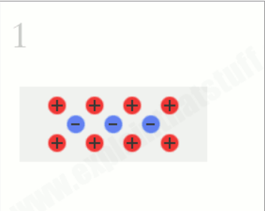
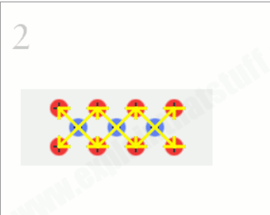
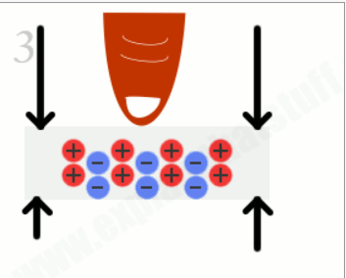
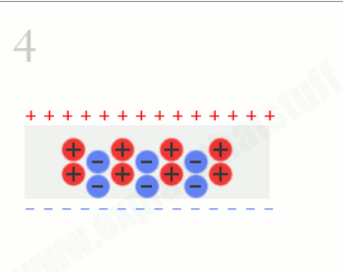
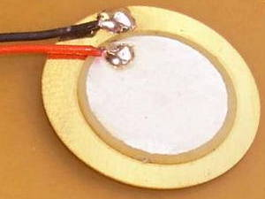
Piezoelectric Sensors
A piezoelectric sensor is a device that uses the piezoelectric effect, to measure change in pressure, acceleration, strain or force by converting them to an electric charge.
DC voltage is proportional to the stress applied on the surface of sensor.
Reference : http://www.explainthatstuff.com/piezoelectricity.html

Slide 5
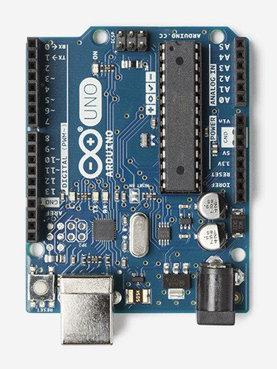
Arduino UNO
Not every pin on a microcontroller has the ability to do analog to digital conversions. On the Arduino board, these pins have an ‘A’ in front of their label (A0 through A5) to indicate these pins can read analog voltages.
Reads the value from the specified analog pin. The Arduino board contains a 6 channel (8 channels on the Mini and Nano, 16 on the Mega), 10-bit analog to digital converter. This means that it will map input voltages between 0 and 5 volts into integer values between 0 and 1023. This yields a resolution between readings of: 5 volts / 1024 units or, .0049 volts (4.9 mV) per unit.
Reference: https://www.arduino.cc/en/Main/ArduinoBoardUno

Slide 6
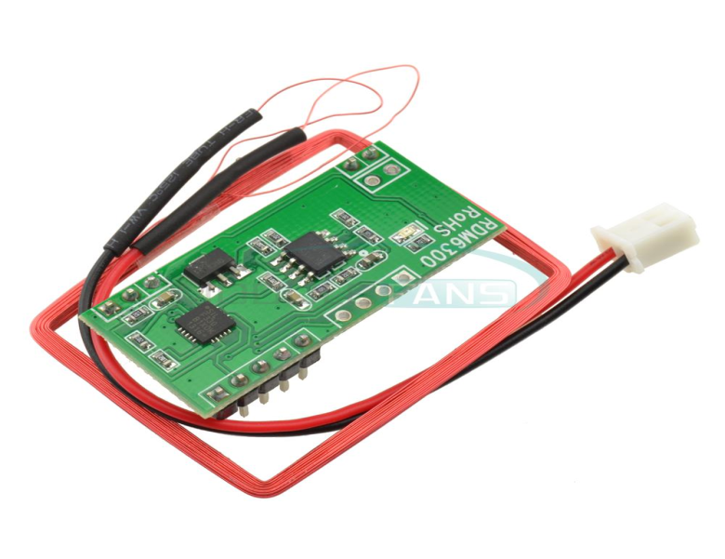
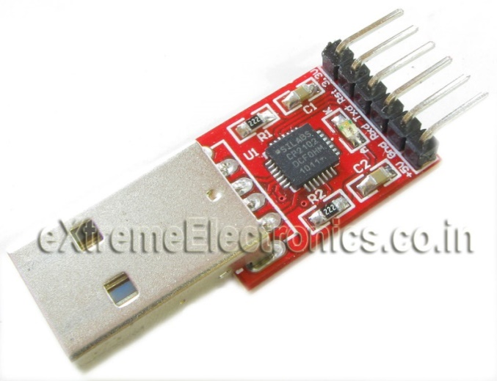
RFID Reader & UART Interface
RDM 125KHz card mini-module is designed for reading code from 125KHz card compatible read tags . It can be applied in office/home security, personal identification, access control etc..
Here we are capturing continuous data
Support external antenna
Maximum effective distance up to 50mm
UART TTL interface
Support EM4100 compatible read only or read/write tags
RFID READER
Reference:
http://wiki.seeedstudio.com/wiki/125Khz_RFID_module_-_UART#How_to_buy
USB 2.0 to TTL Module

Slide 7
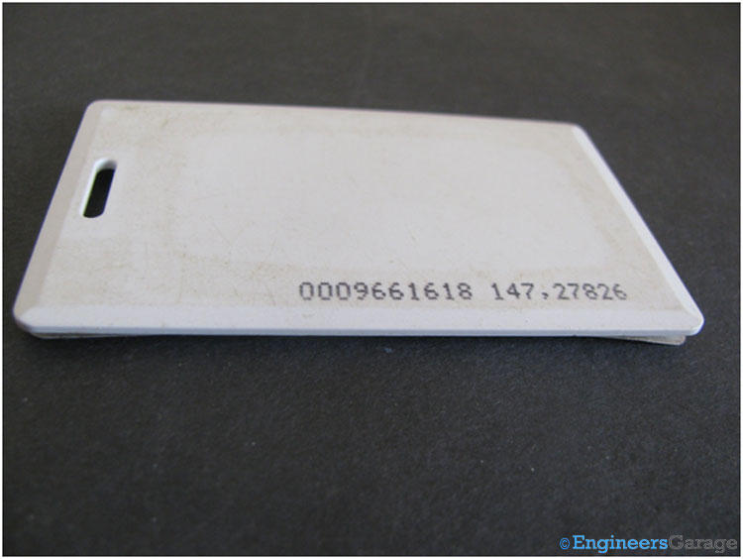
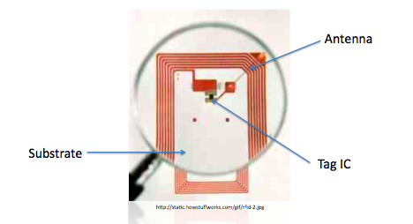
RFID TAGS
Every vehicle carries a RFID tag.
The RFID TAG contains the details about the owner of the vehicle.
The details are needed for transaction processing of the vehicle.
When the RFID tag comes near the active region of the reader, the tag is identified and the information is passed.
In this project we are using 125KHZ RFID key tags.
Reference:
http:http://www.engineersgarage.com/insight/how-rfid-tag-works?page=2

Slide 8
Programming in LabVIEW
It is a visual programming language.
It is a system design platform and development environment
RFID can be interfaced with LabVIEW also using Visa terminals.
Loops, charts functions and other signal manipulation functions are available.
LabVIEW is a graphical programming language created by National Instruments

Slide 9
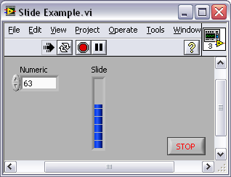
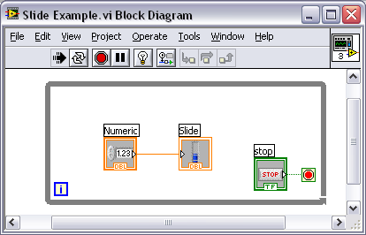
LabVIEW Programs Are Called Virtual Instruments (VI’s)
Each VI has 2 Windows
Front Panel
User Interface (UI)
Controls = Inputs
Indicators = Outputs
Block Diagram
Graphical Code
Data travels on wires from controls through functions to indicators
Blocks execute by Dataflow

Slide 10
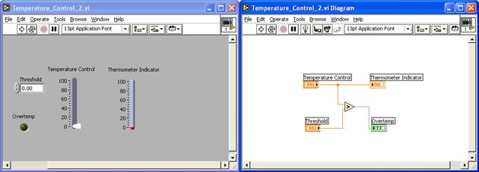
LabVIEW
Front Panel Window
temperature
Indicator
Output
Terminal
Block Diagram Window
Boolean
Control
Input
Terminals
Reference:
http://engineering.sdsu.edu/~johnston/me295/modules/labview/tutorials_and_exercises/temperature_control_2.htm

Slide 11
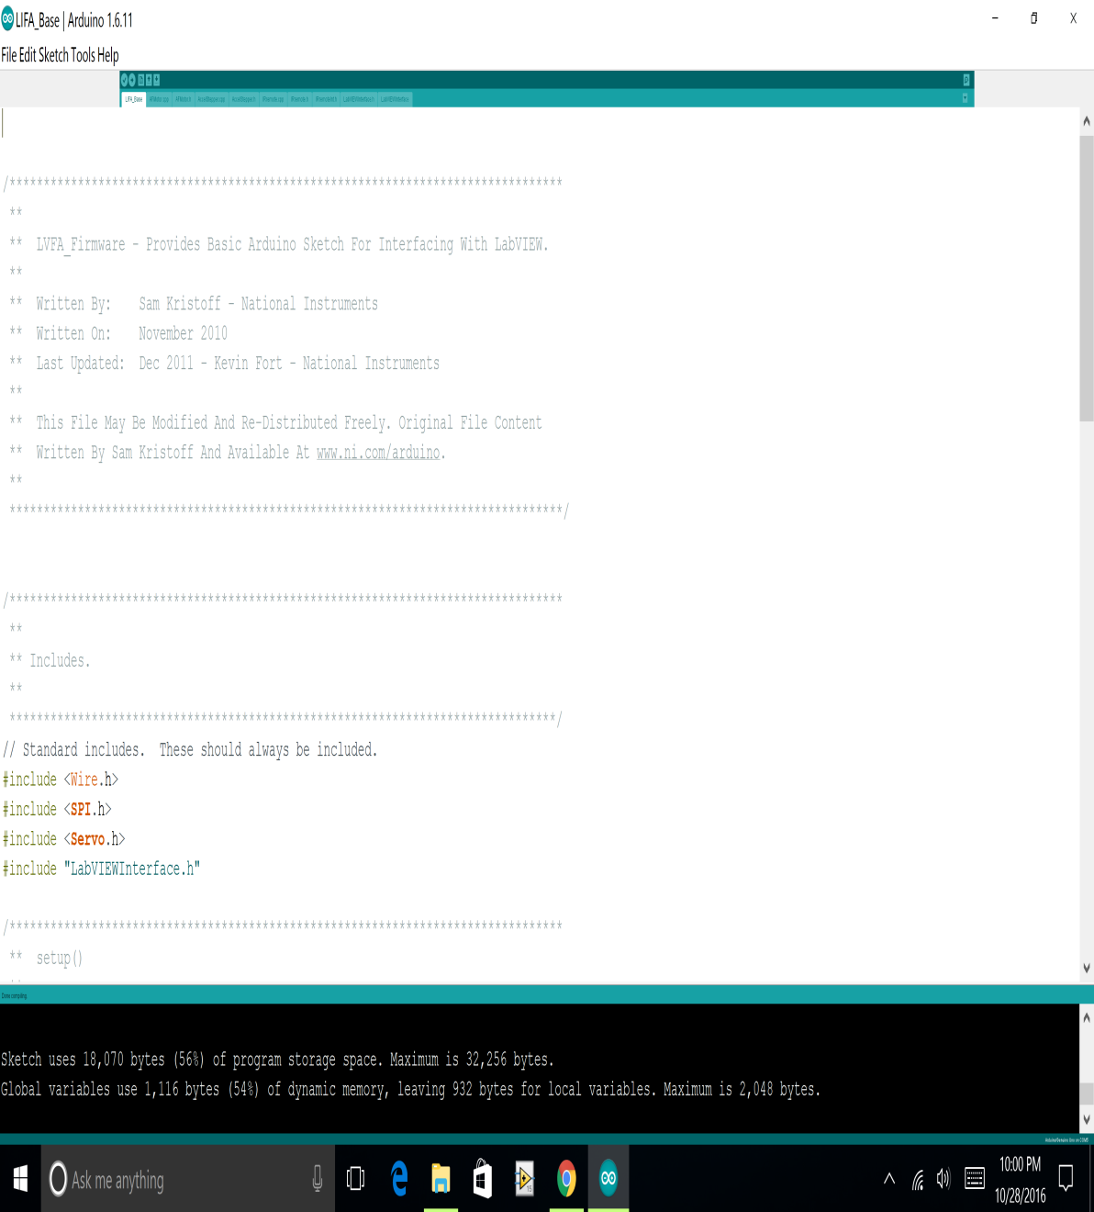
LabVIEW Interfacing For Arduino
In order to interface LabVIEW with Arduino we have to dump the LIFA Base code in Arduino.
We can download the LIFA Base from NATIONAL INSTRUMENTS website.
We can dump LIFA Base code in Arduino board using Arduino software.
Reference: http:https://decibel.ni.com/content/docs/DOC-30365

Slide 12
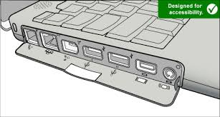
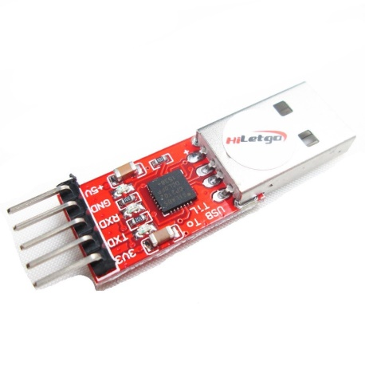
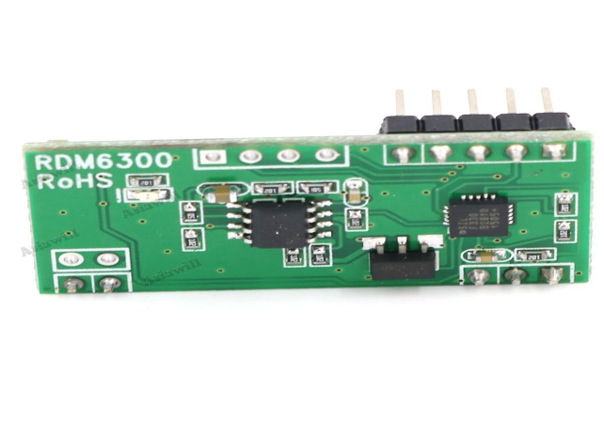
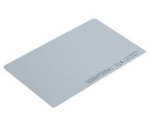
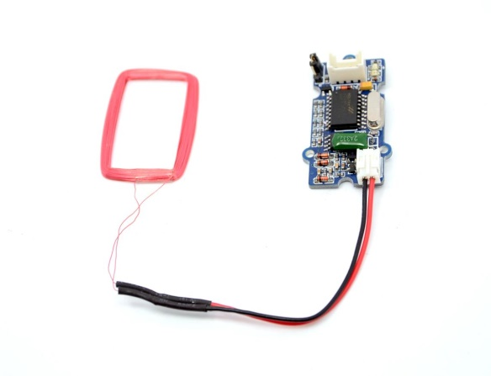
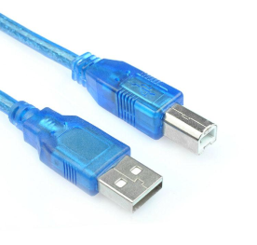
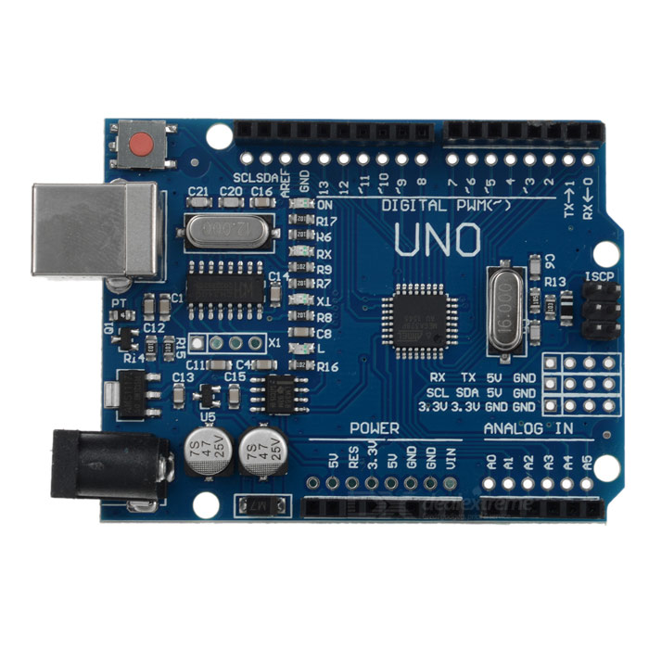
Hardware Interfacing
RFID Reader
COM 3
USB UART
RFID tag
USB type B cable
COM 4
LEDS
Piezoelectric Sensors
buzzer
4
3
2
1
A0
A1
Arduino UNO Board
A2
A3

Slide 13
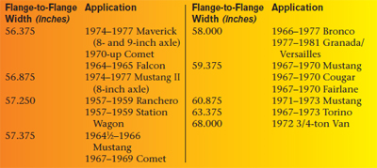
Axial Width Of Vehicles
Few popular Vehicles
Axle width lorry in centimetre
Ashok Leyland lorry -95.7
Tata lorry -84.252
Volvo Bus -93
Ashok Leyland Truck -95.6
Tata Motors 3118 Trucks -95.8
Reference : http://diyford.com/ford-axle-history-identification-ford-differentials/#

Slide 14
Toll Rates For The Proposed System
BIKE TOLL - 10$
CAR TOLL - 20$
TRUCK TOLL - 30$
VIOLATION TOLL - 40$

Slide 15
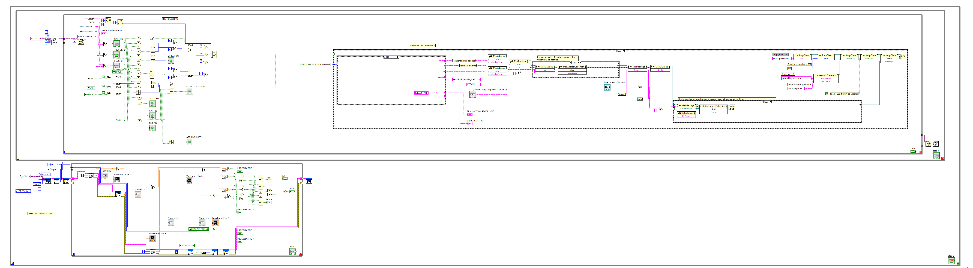
LabVIEW Program For The Proposed System

Slide 16
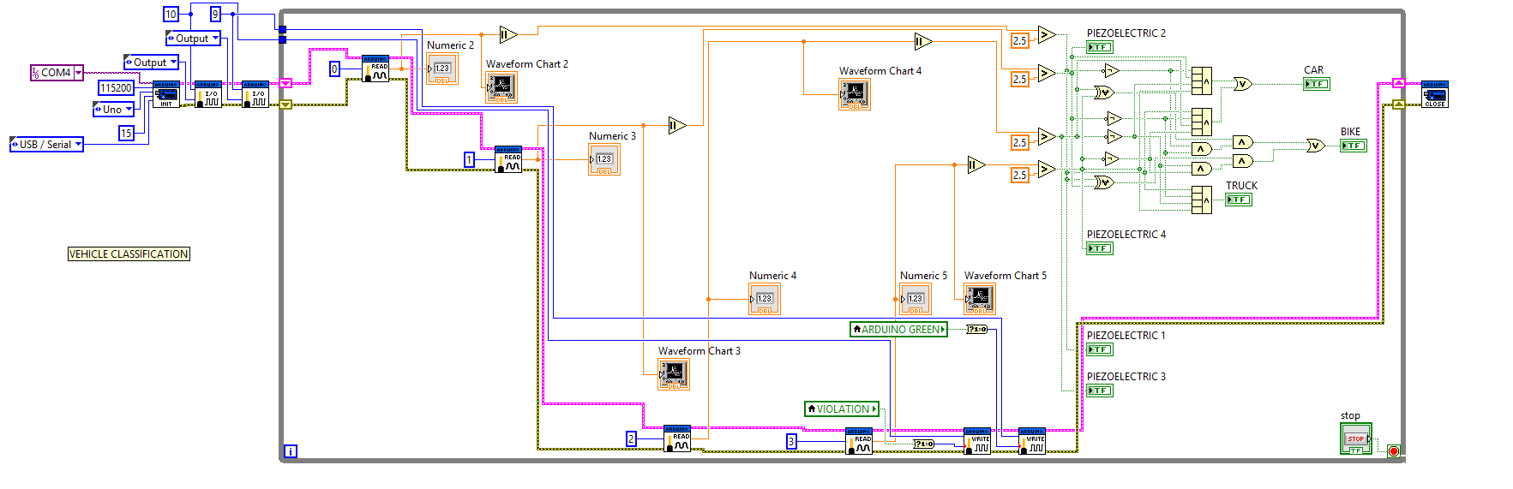
Program Continued

Slide 17
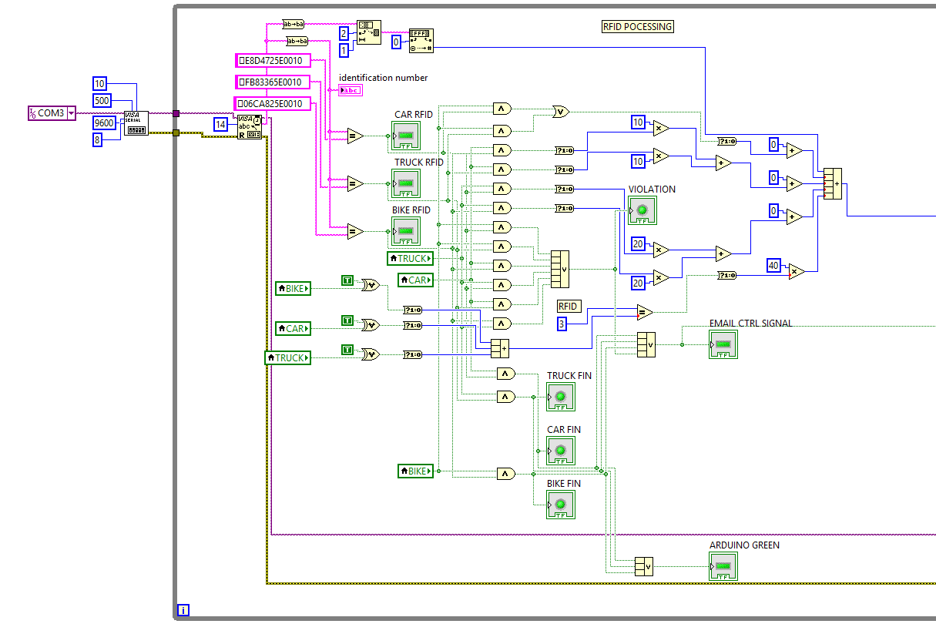
Program Continued

Slide 18
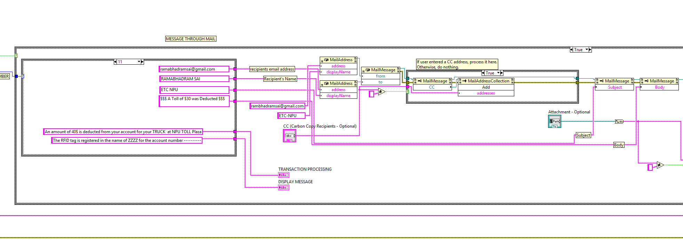
Program Continued

Slide 19
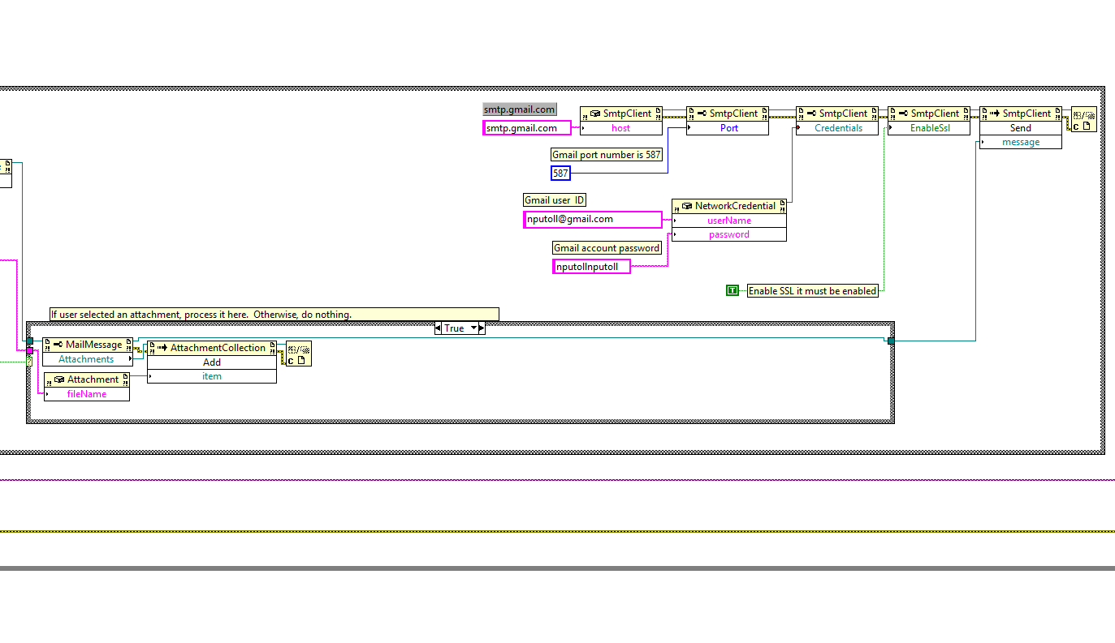
Program Continued

Slide 20
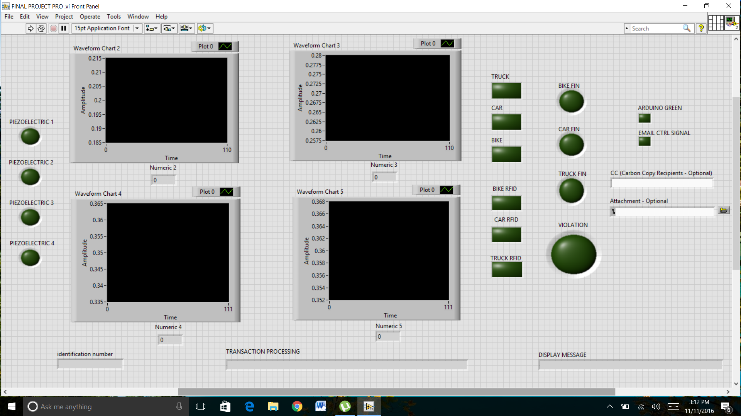

Slide 21
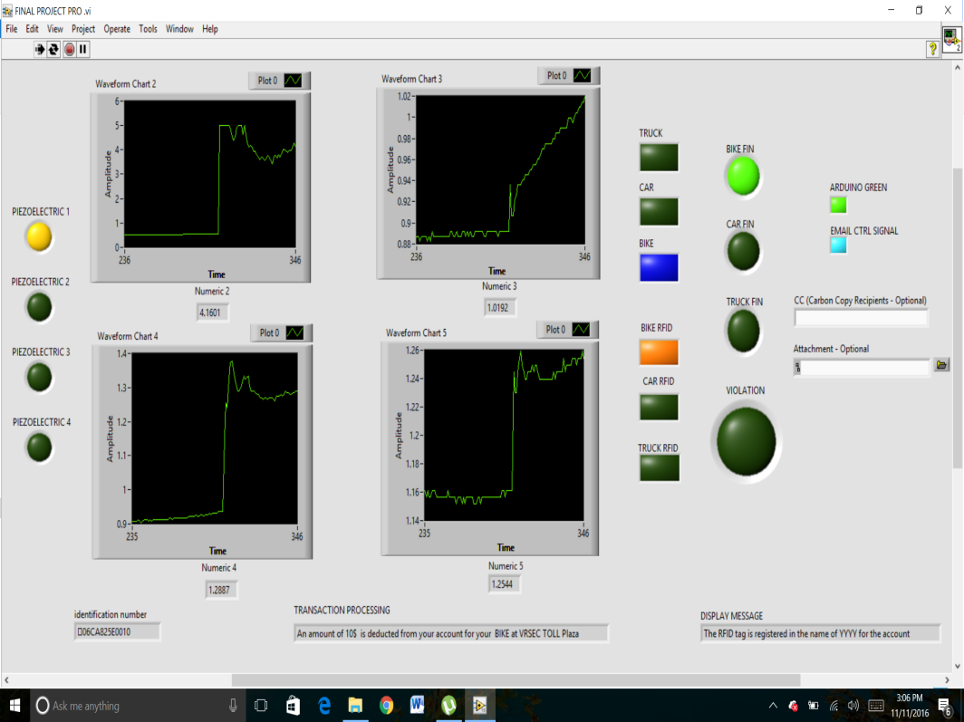
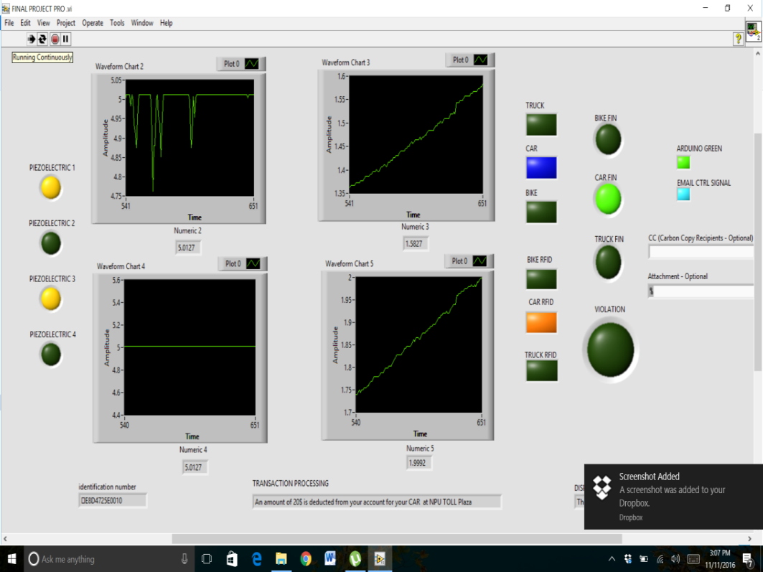
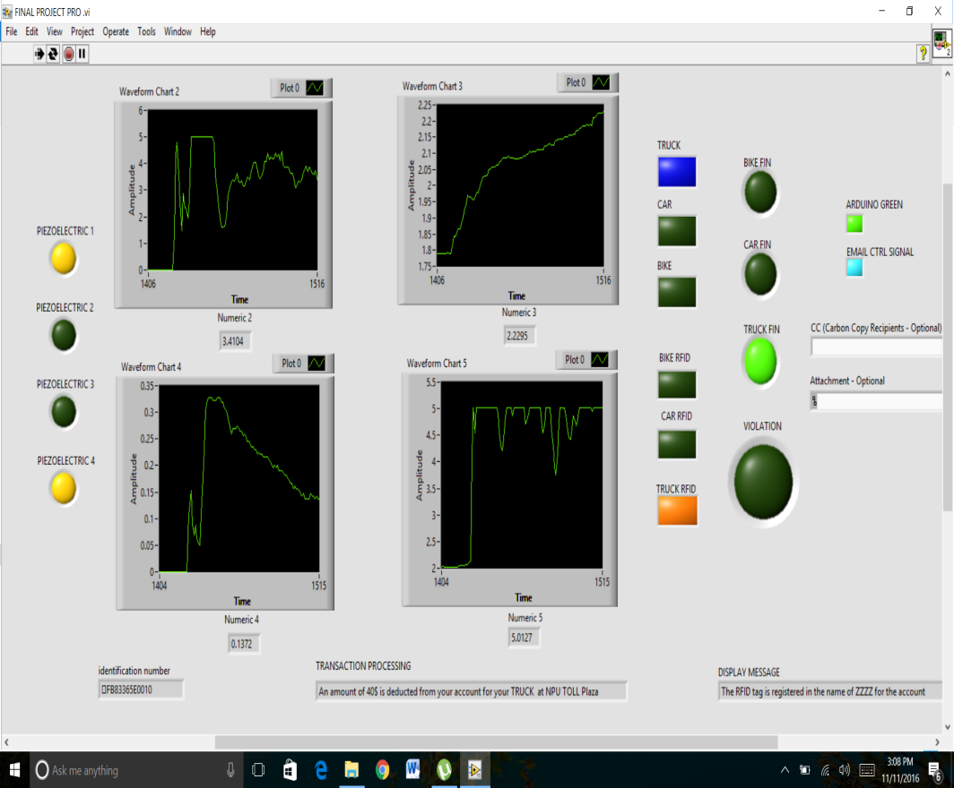

Slide 22
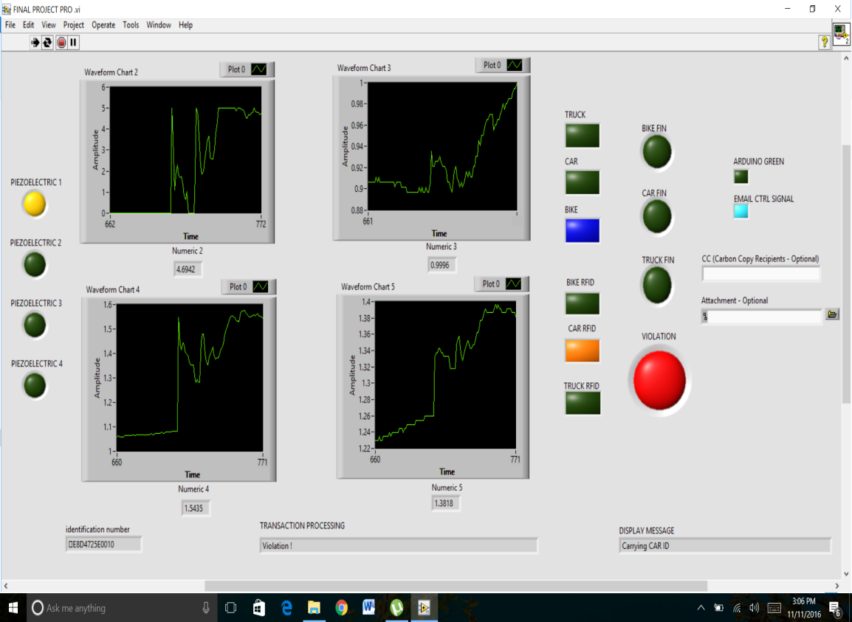
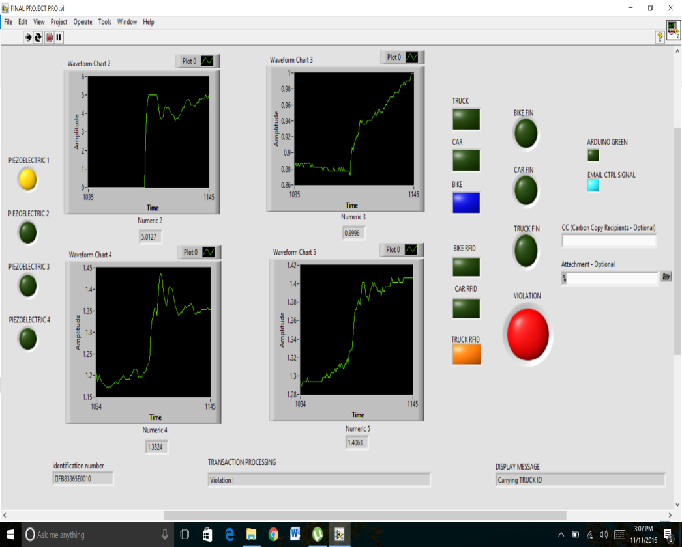
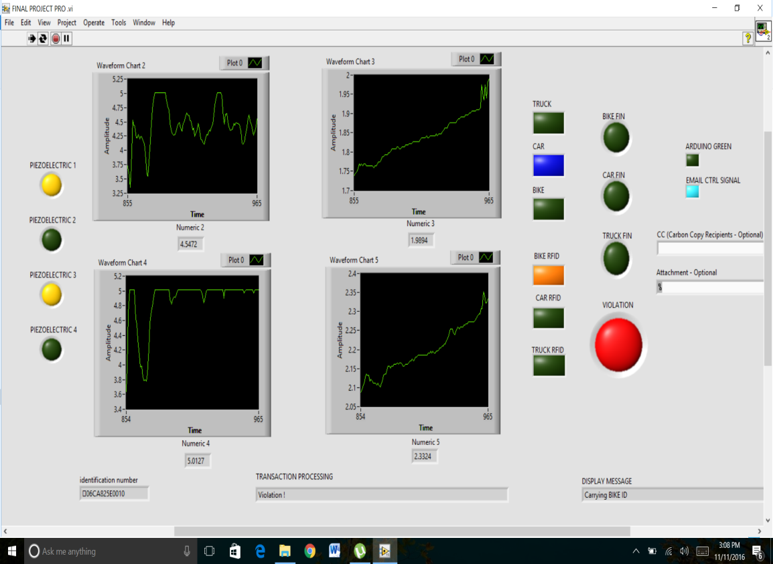

Slide 23
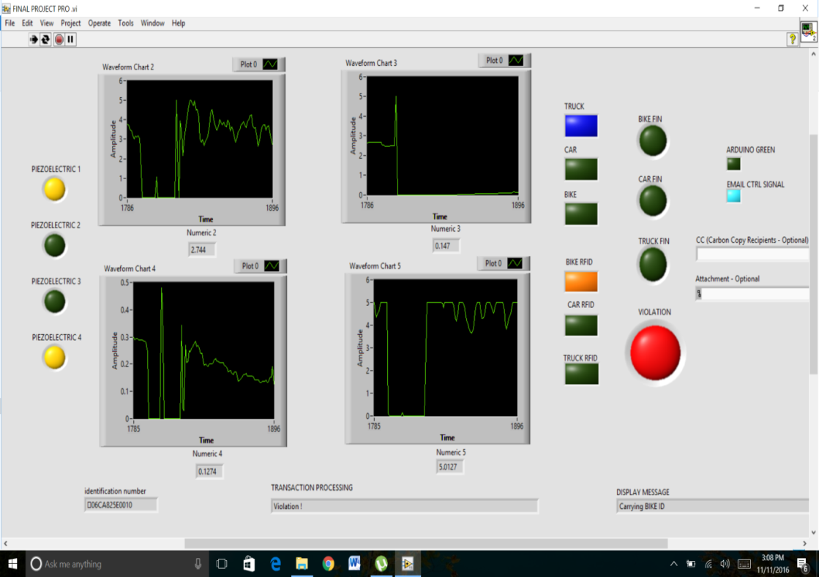
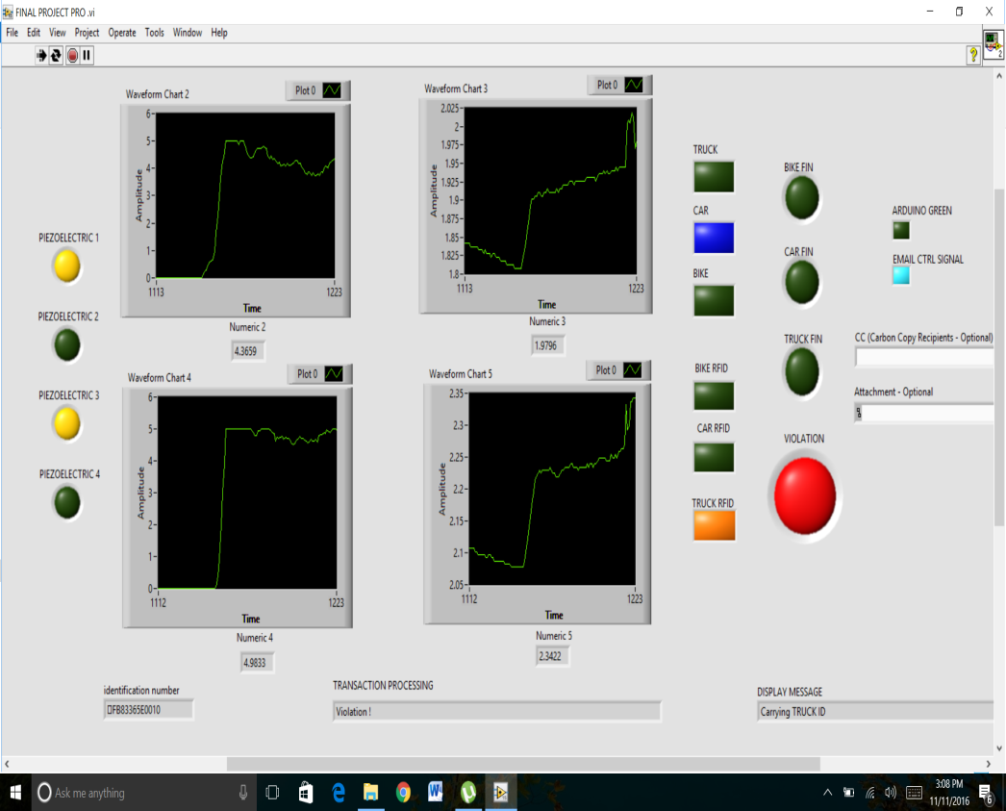
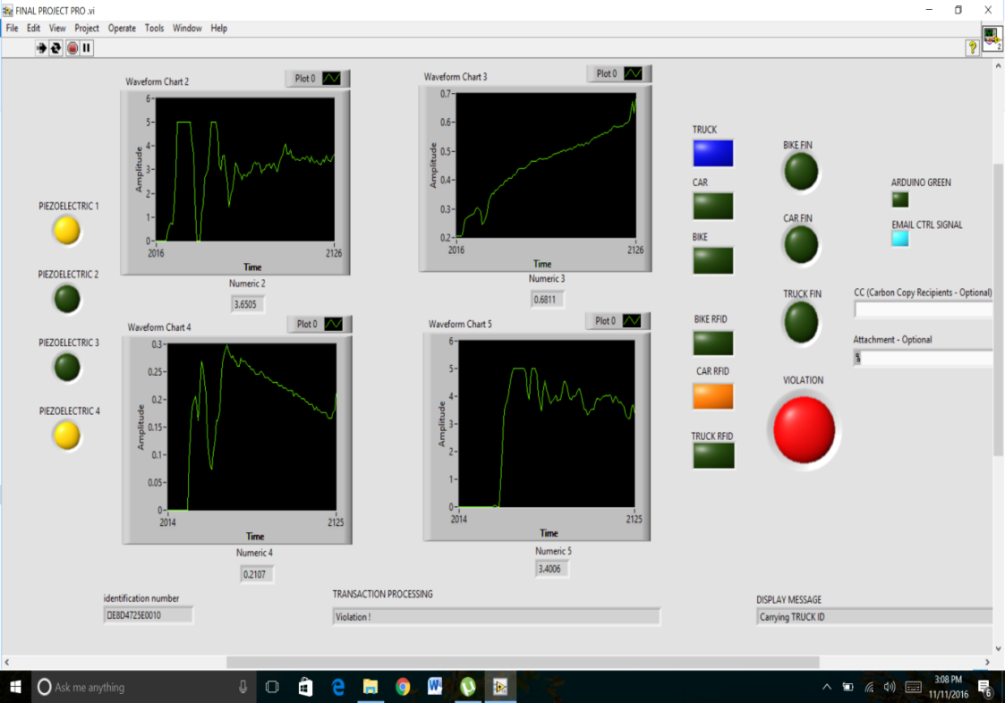

Slide 24
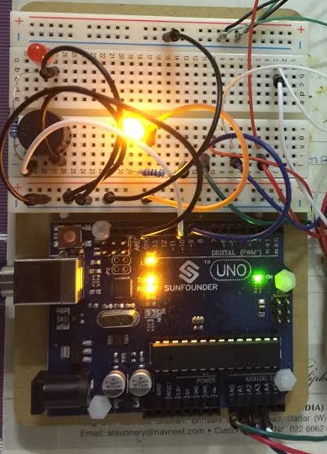
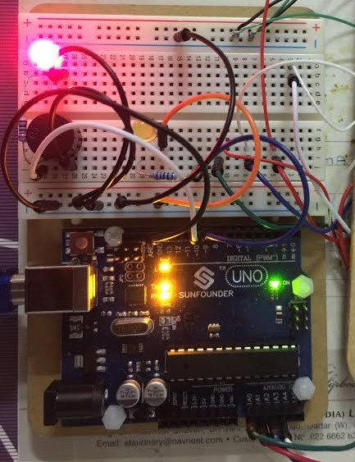
When vehicle is classified the Yellow LED glows and if any Violation occurs the Red LED glows

Slide 25
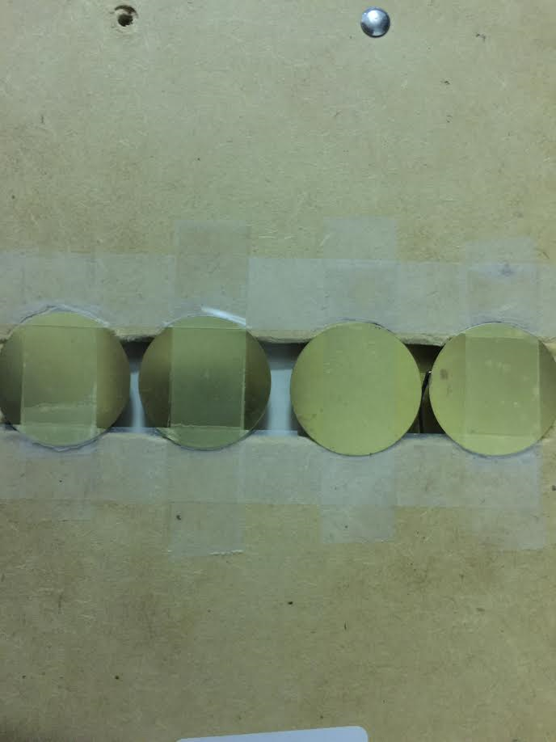
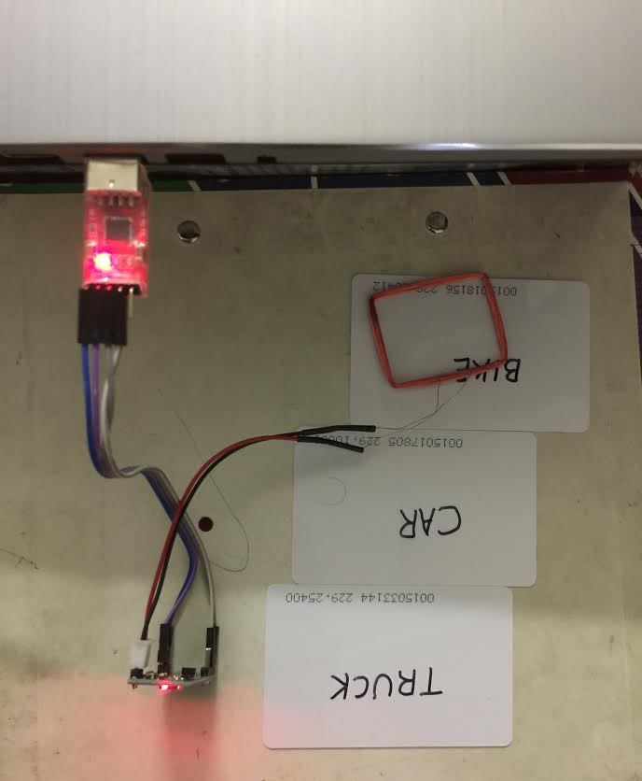
Piezoelectric Sensors alignment
RFID Reader and Cards

Slide 26

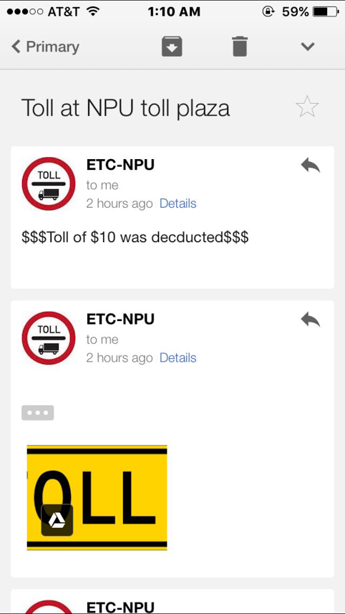
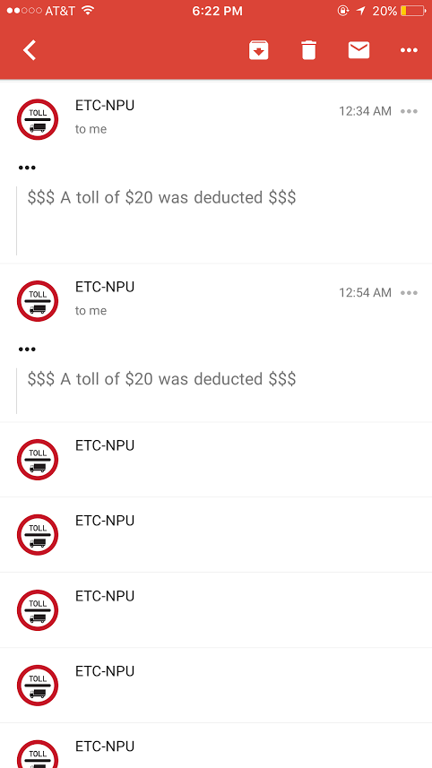
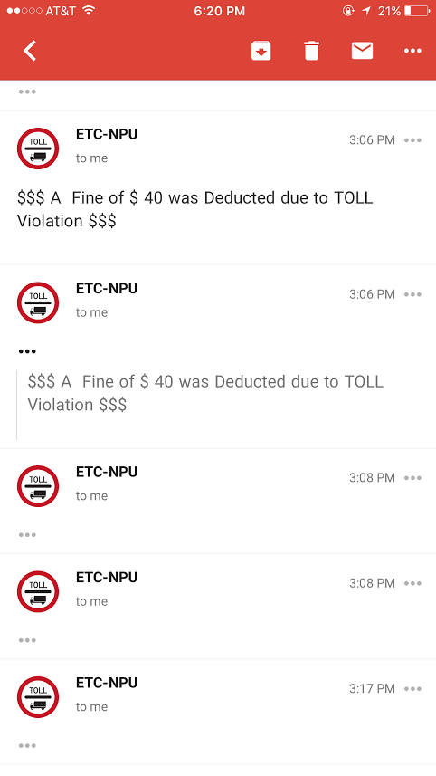
Truck Toll message
Bike Toll message
Car Toll message
Violation Toll message

Slide 27
THANK YOU

